Slide 1

Games !!
A few demo programs using pygame and pygwidgets.
Each program will present one or more reusable classes and show how they can be used in sample projects.

Slide 2
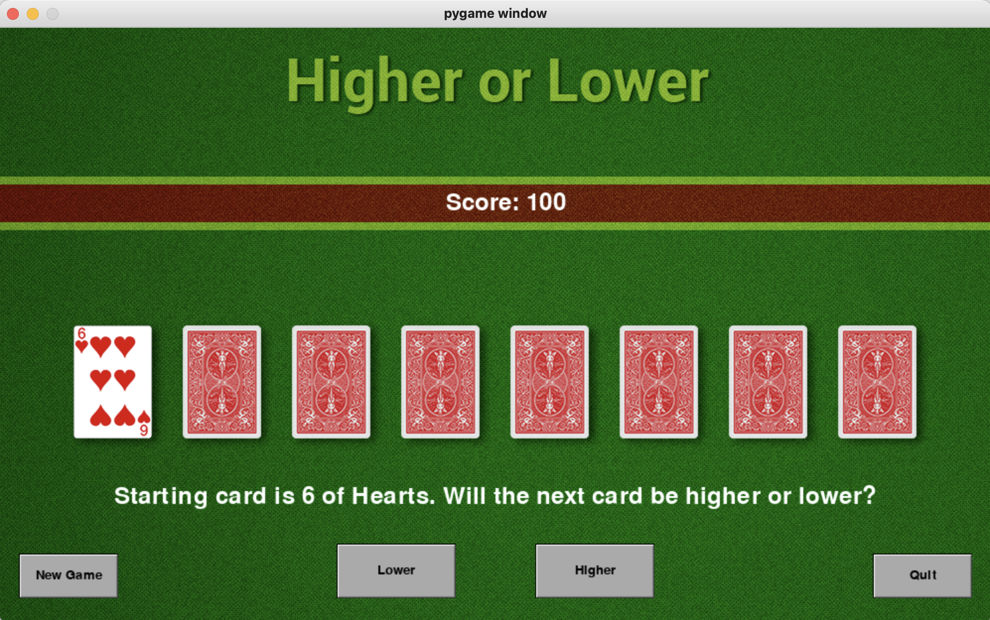

Slide 3
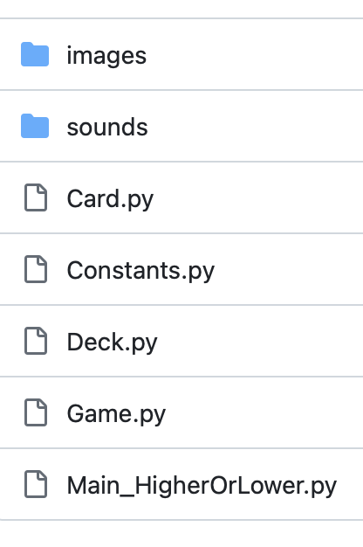
Card Game
Game rules:
We start with seven cards face down and one card face up.
The player guesses whether the next card to be turned over will be higher or lower than the last visible card by pressing Lower or Higher.
When the game is over, the user can click “New Game” to start a new round of the game.
The player starts with 100 points, gains 15 points for a correct answer, and loses 10 points for an incorrect answer.

Slide 4
Program Design
Card
Deck
Game
Main

Slide 5
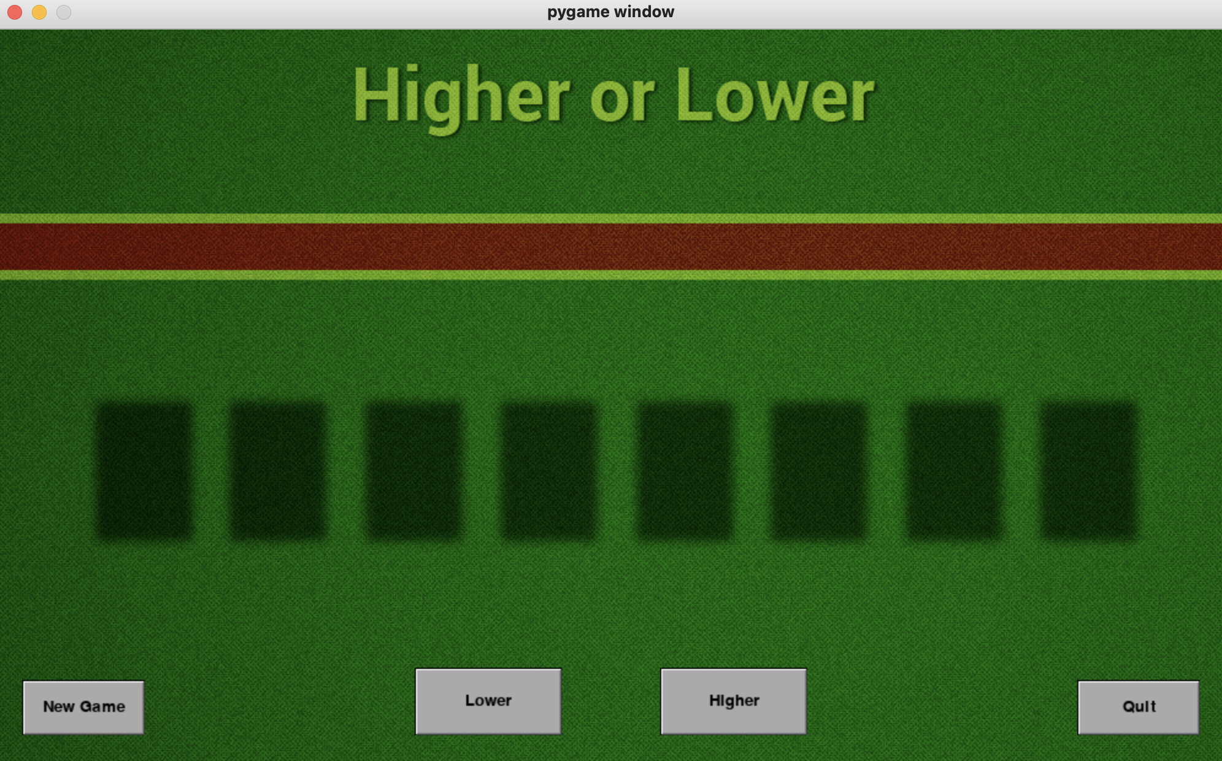
Step-01
Background
Main
Game
Deck
Buttons
Card

Slide 6
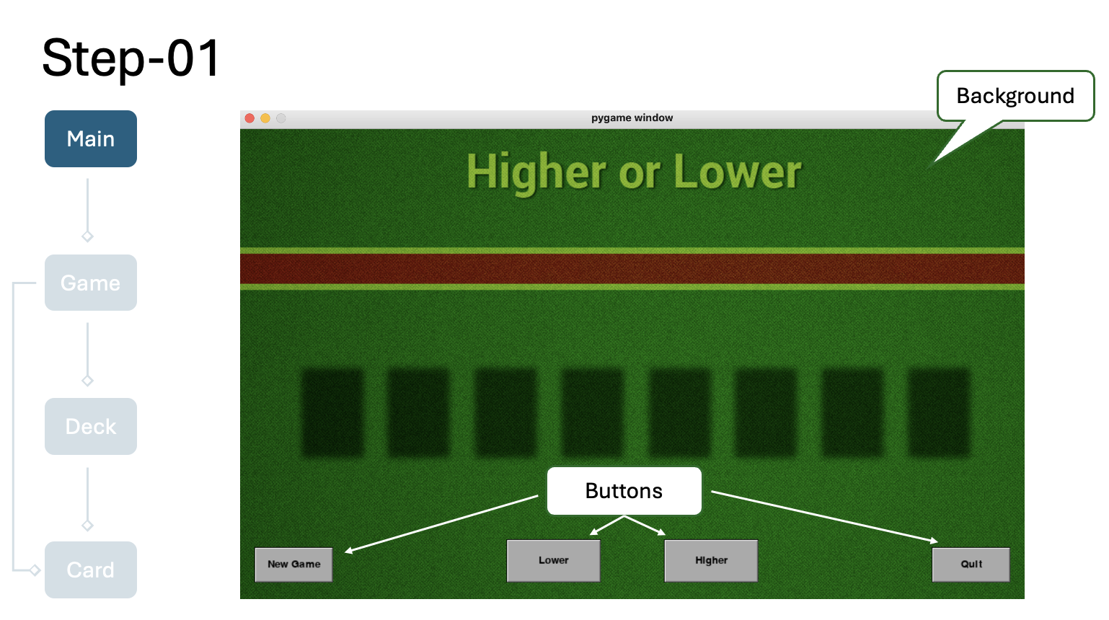
Main Program
Sets up the world and contains the main loop.

Slide 7
Step-02
Main
scoreText
Game
cardList
oCard
Deck
messageText
Card

Slide 8
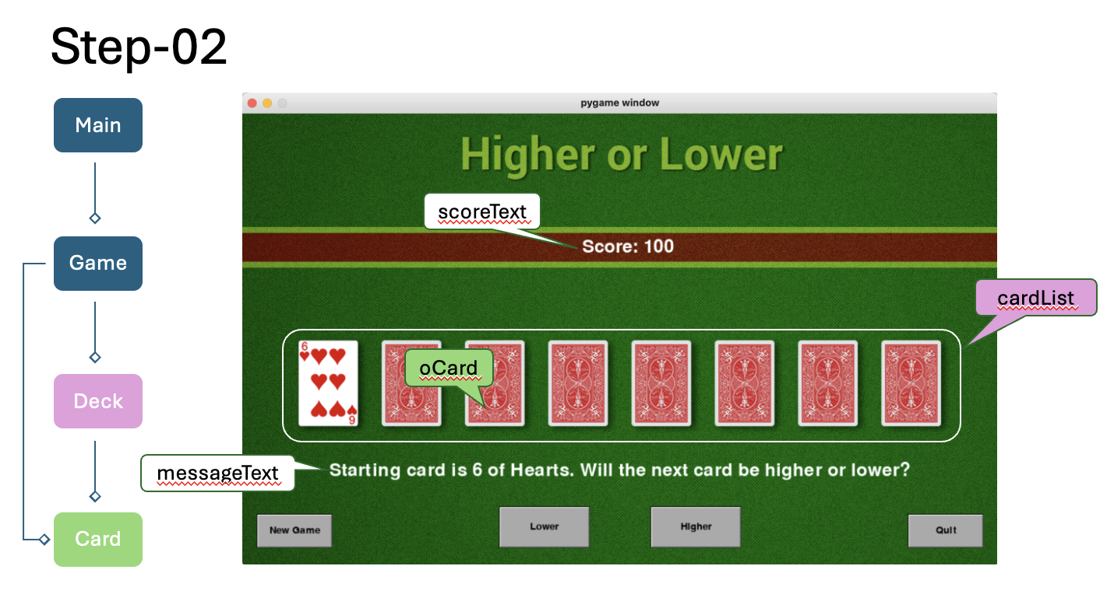
Game Class: To handle the actual game logic
The Game object that runs the game.
Data
Methods
window
oDeck
score
scoreText
messageText
loserSound
winnerSound
cardShuffleSound
cardXPositionsList
cardNumber
__init__()
reset()
getCardNameAndValue()
showCard()
hitHigherOrLower()
draw()

Slide 9
Deck Class: An object manager to create and manage 52 Card objects
Data
Methods
startingDeckList
playingDeckList
__init__()
shuffle() randomizes the deck
getCard() retrieves a card from the deck
returnCardToDeck() put a card back into the deck

Slide 10
Card Class: To represent a card
Data
Methods
Rank (ace, 2, 3, ... 10, jack, queen, king)
Suit (clubs, hearts, diamonds, spades)
Value (1, 2, 3, ... 12, 13)
Name (built using the rank and suit: for example, 7 of clubs)
Image of the back of the card (a single image shared by all Card objects)
Image of the front of the card (a unique image for each Card object)
__init__()
conceal()
reveal()
getName()
getValue()
getSuit()
getRank()
setLoc()
getLoc()
draw()

Slide 11
Step-03
Main
Game
Algorithms
Deck
Card

Slide 12
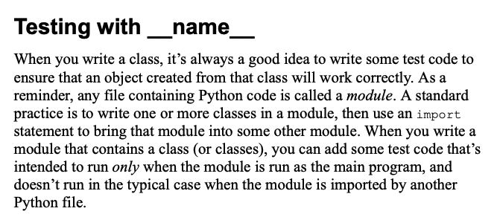
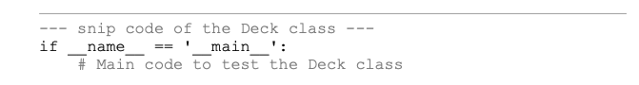

Slide 13
References
https://github.com/IrvKalb/Object-Oriented-Python-Code/tree/master/Chapter_12/HigherOrLower

Slide 14

Sprites and Platforms
A sprite is a two-dimensional image that is part of the larger graphical scene.
Good platforms can move side to side -- scrolling platform.
Even cooler platform games have platforms that move!

Slide 15
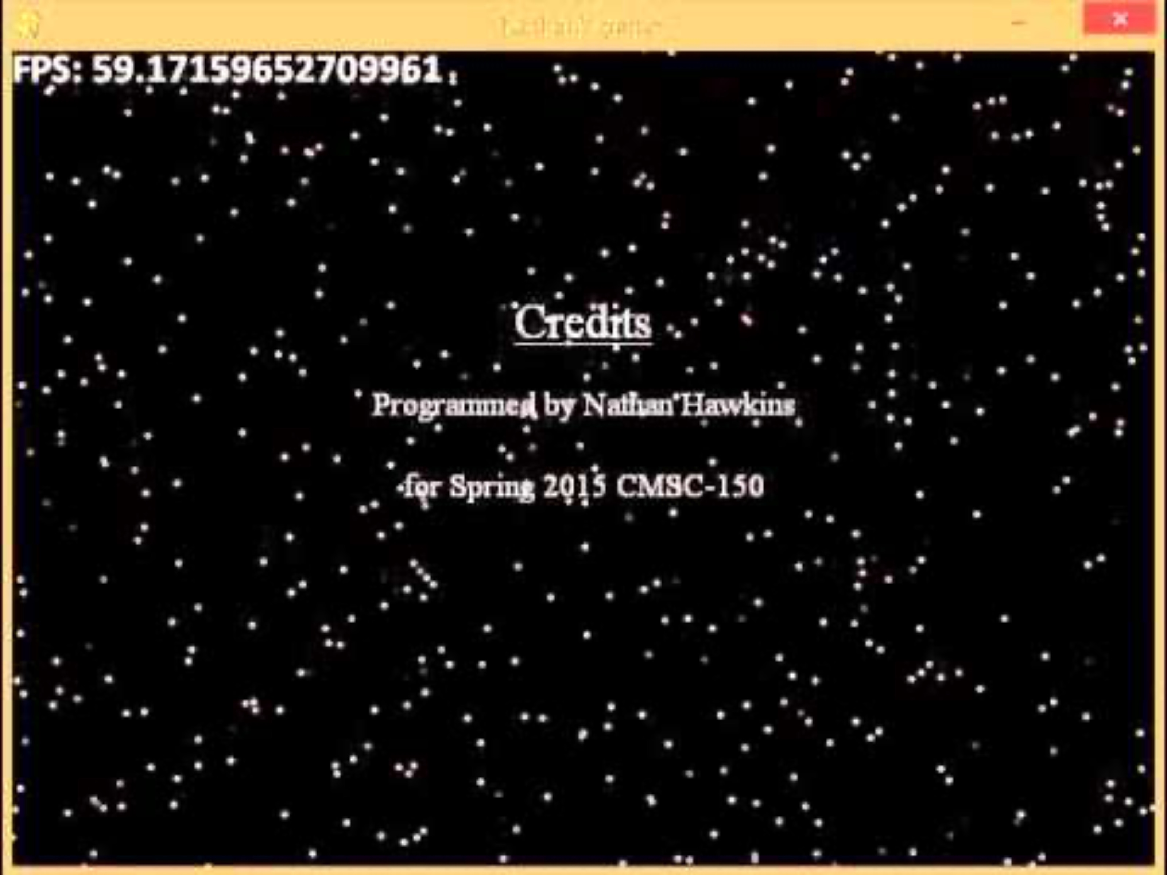
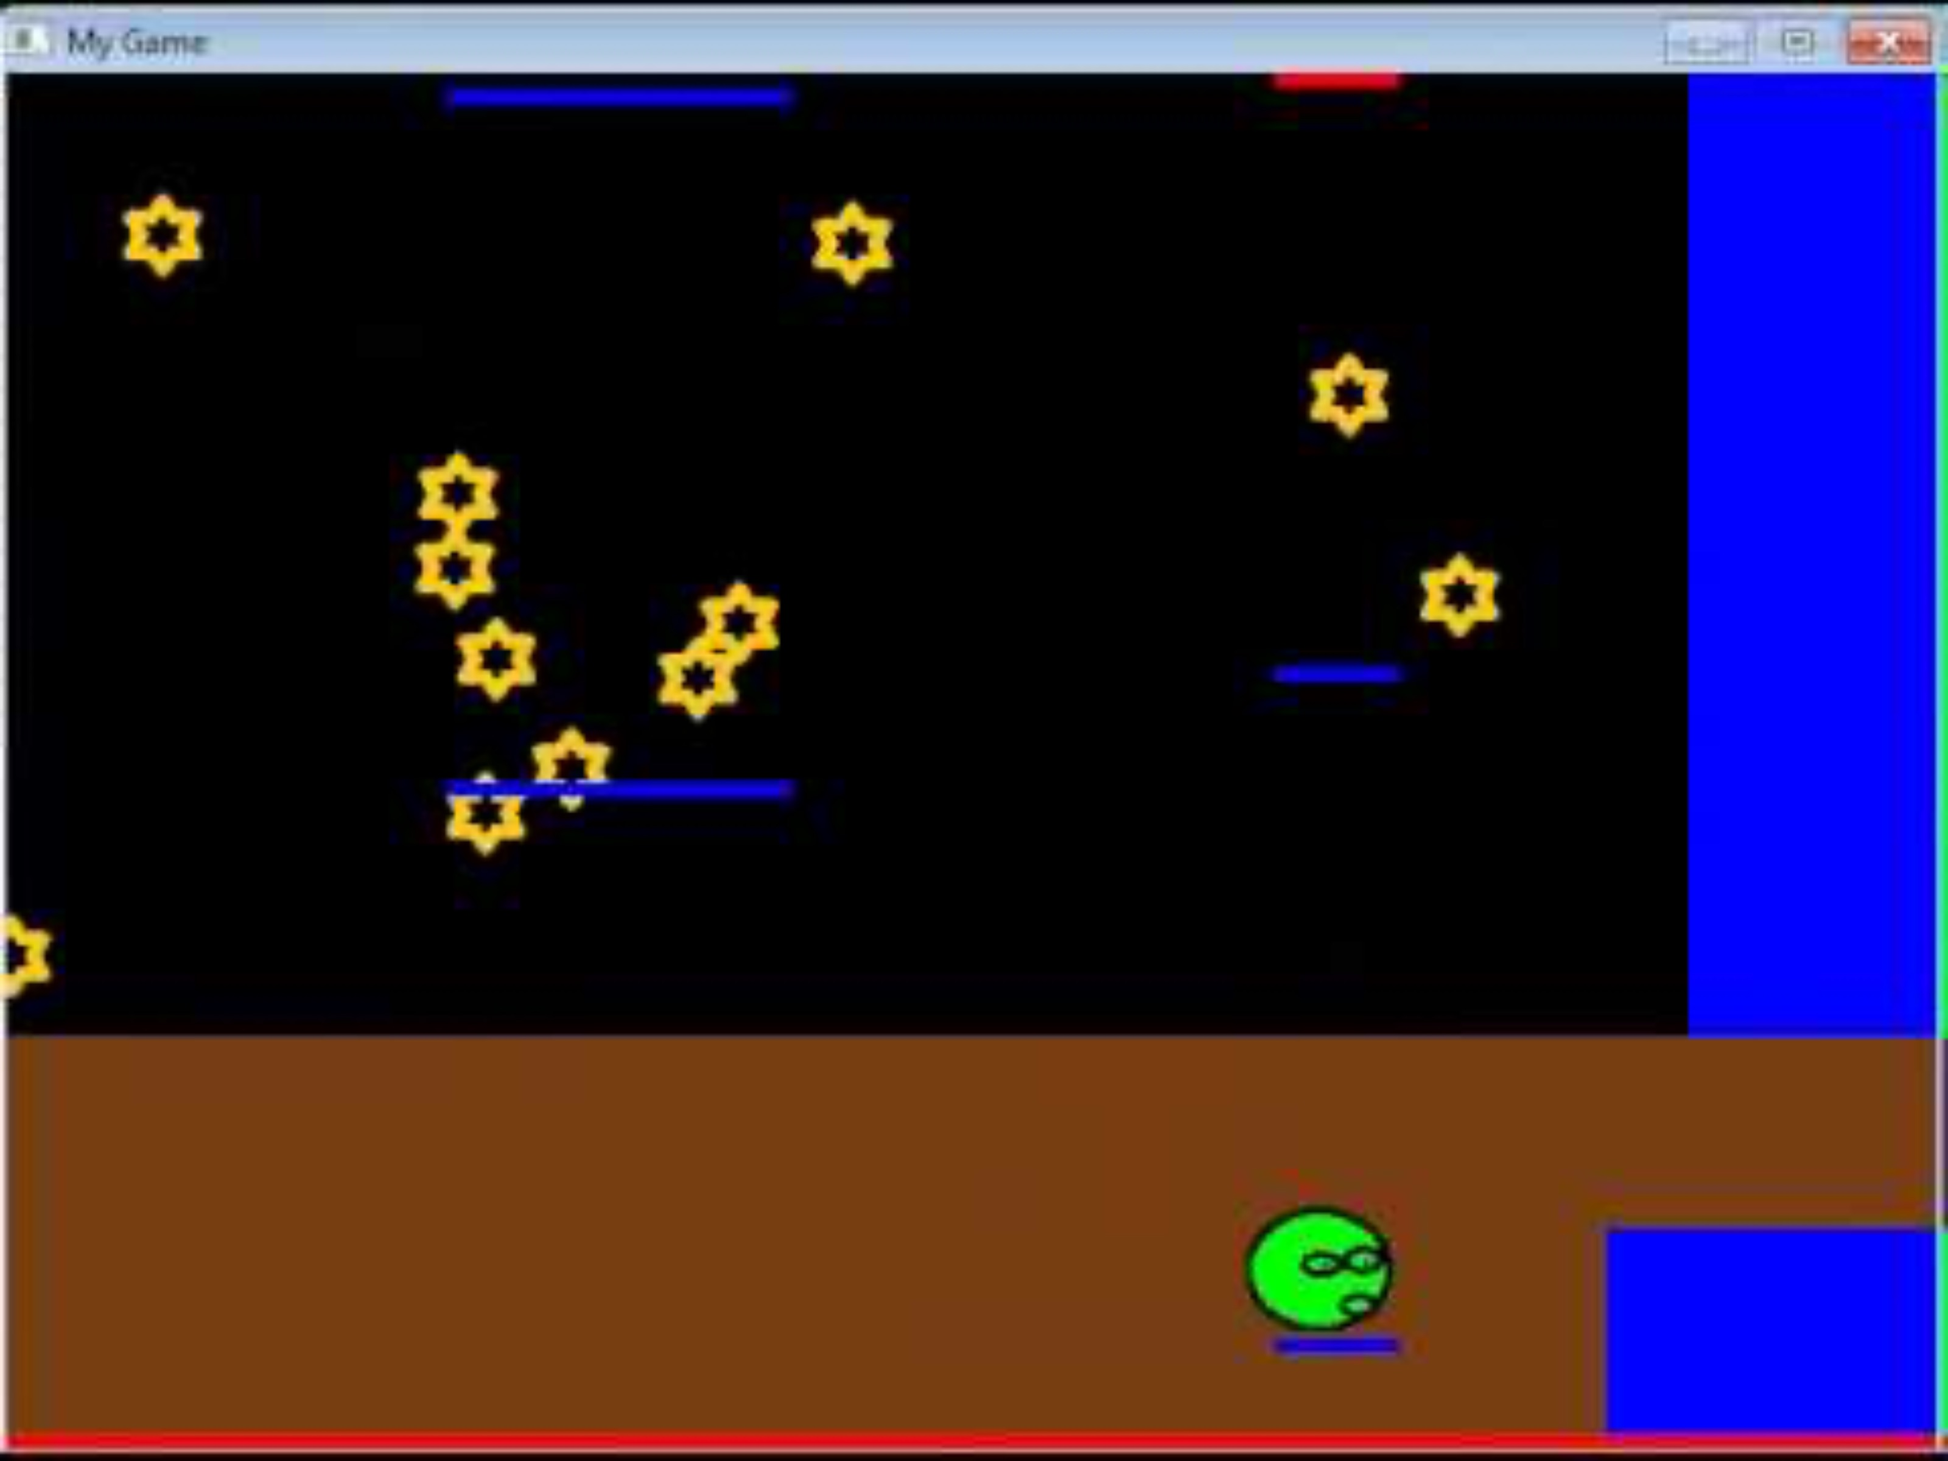
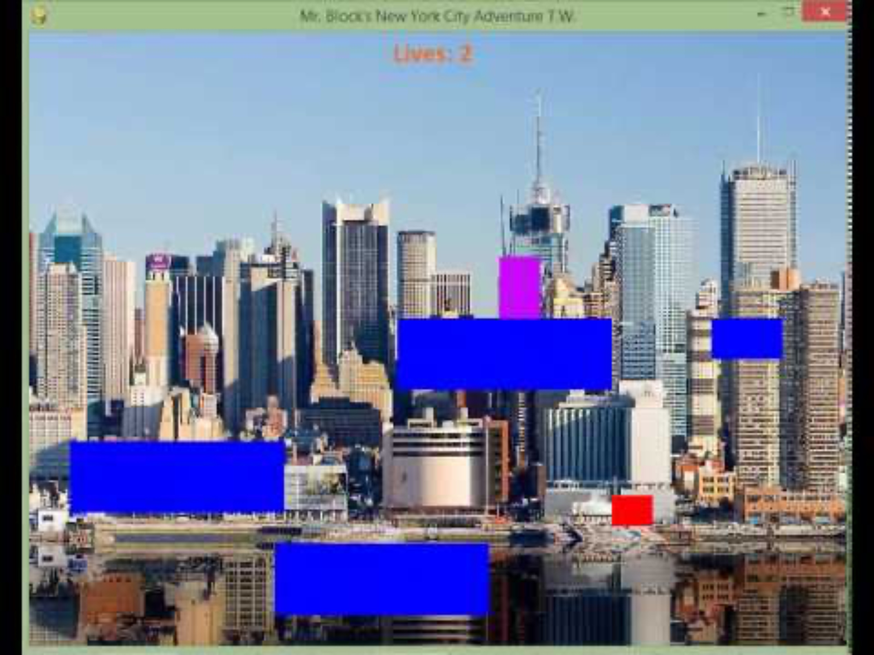
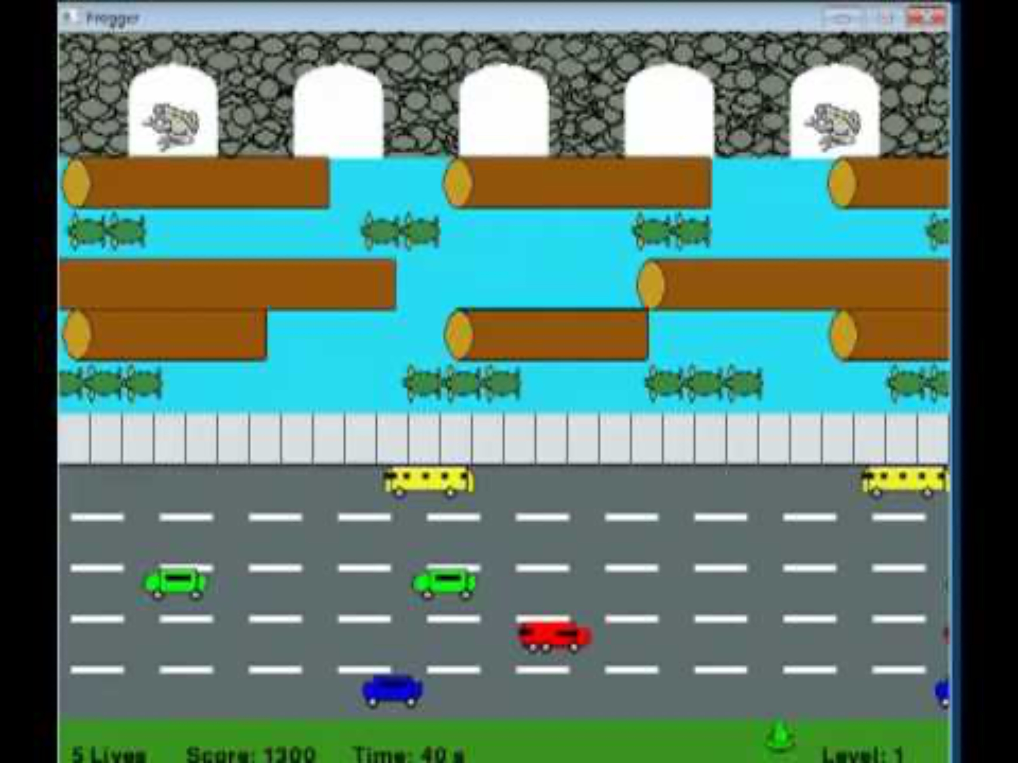
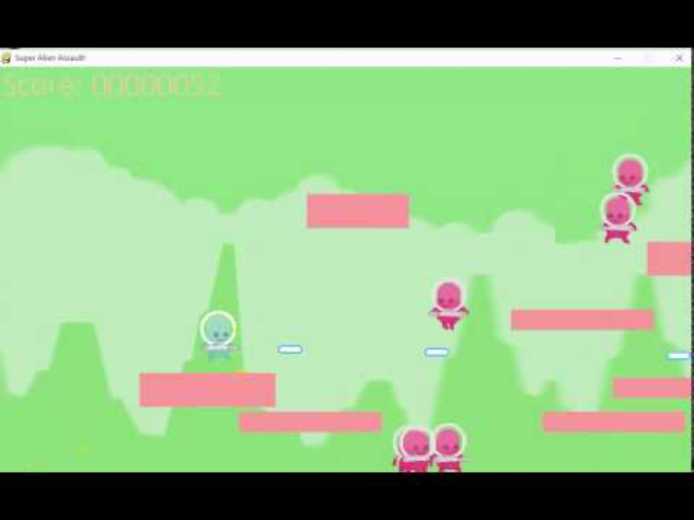
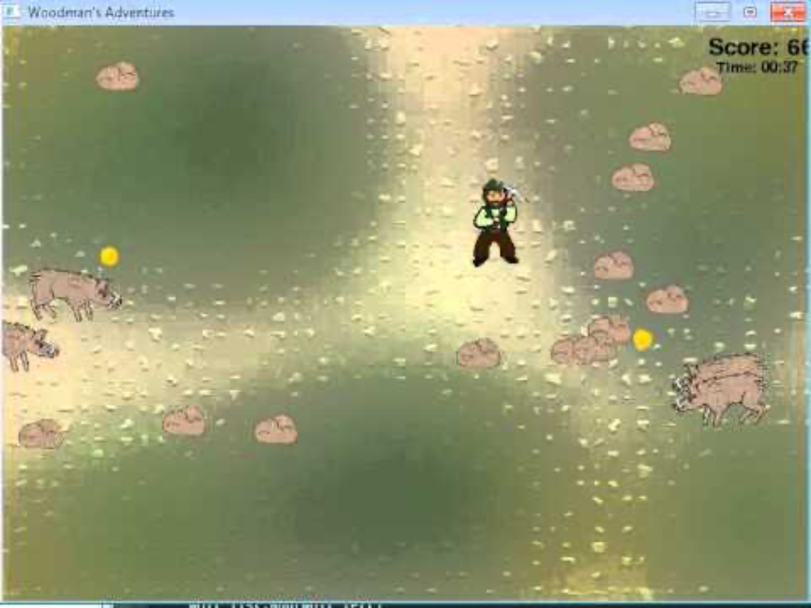
Example of Arcade Games
http://programarcadegames.com/index.php?chapter=introduction_to_sprite

Slide 16
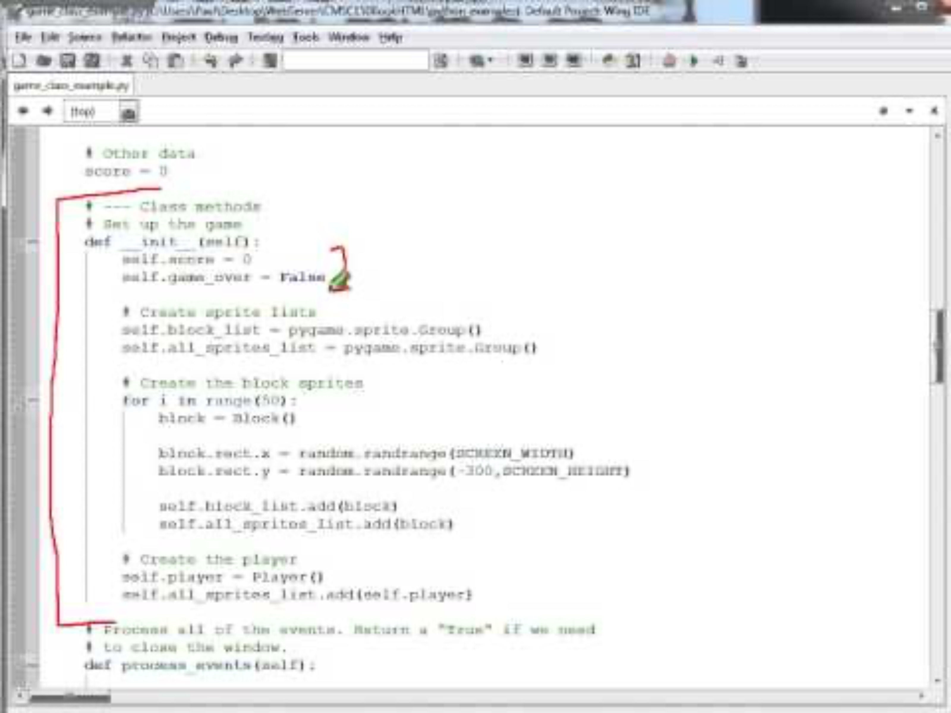
Collecting Blocks Game
Block
Game
Main
Player
http://programarcadegames.com/python_examples/show_file.php?file=game_class_example.py (0:29)

Slide 17
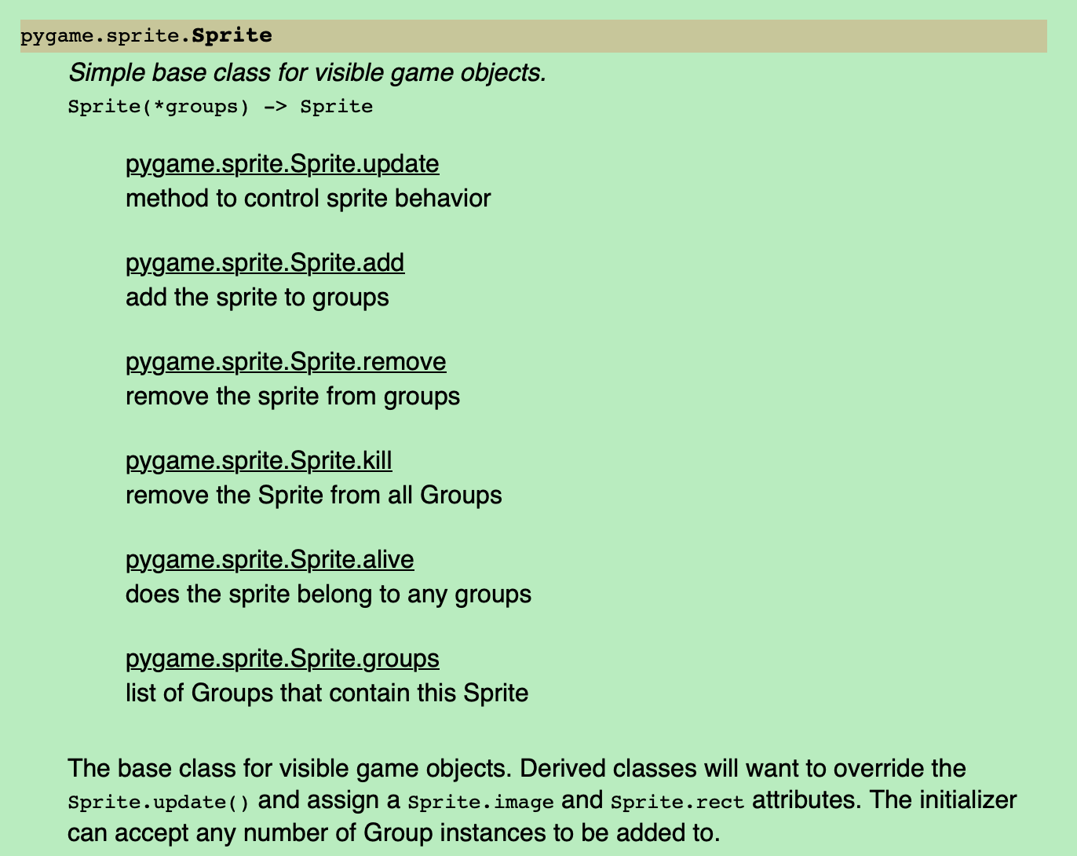

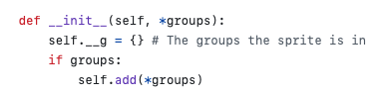
pygame.sprite.Sprite
Ref: https://github.com/myint/pygame/blob/master/lib/sprite.py
Ref: https://www.pygame.org/docs/ref/sprite.html#pygame.sprite.Sprite

Slide 18
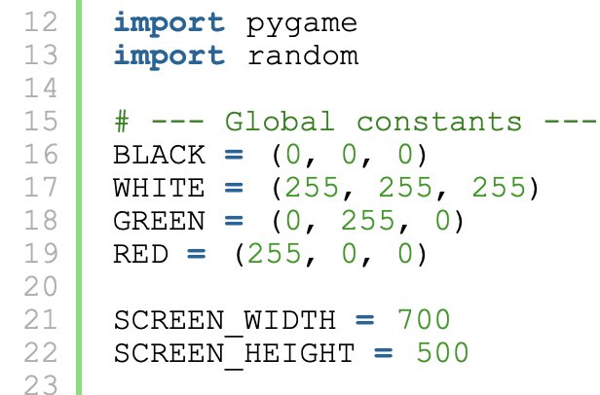
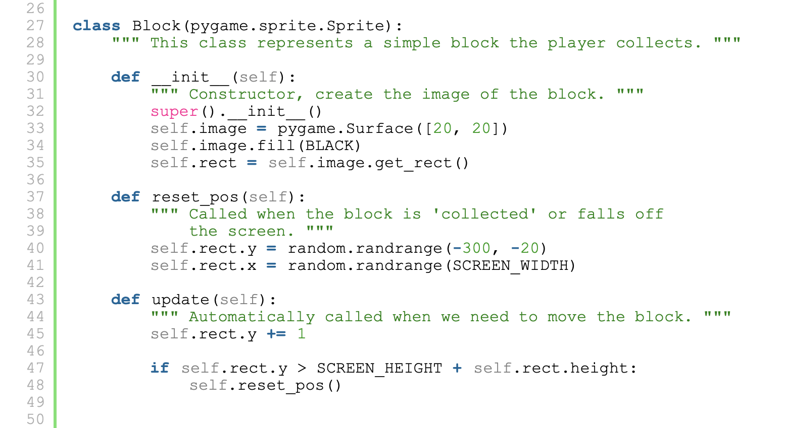
Collecting Blocks Game

Slide 19
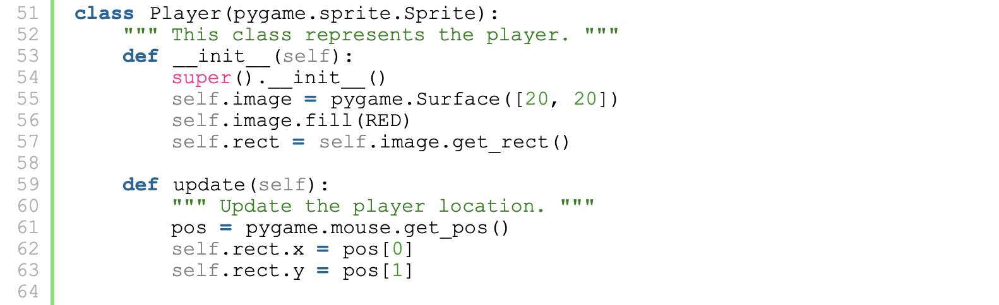
Collecting Blocks Game

Slide 20
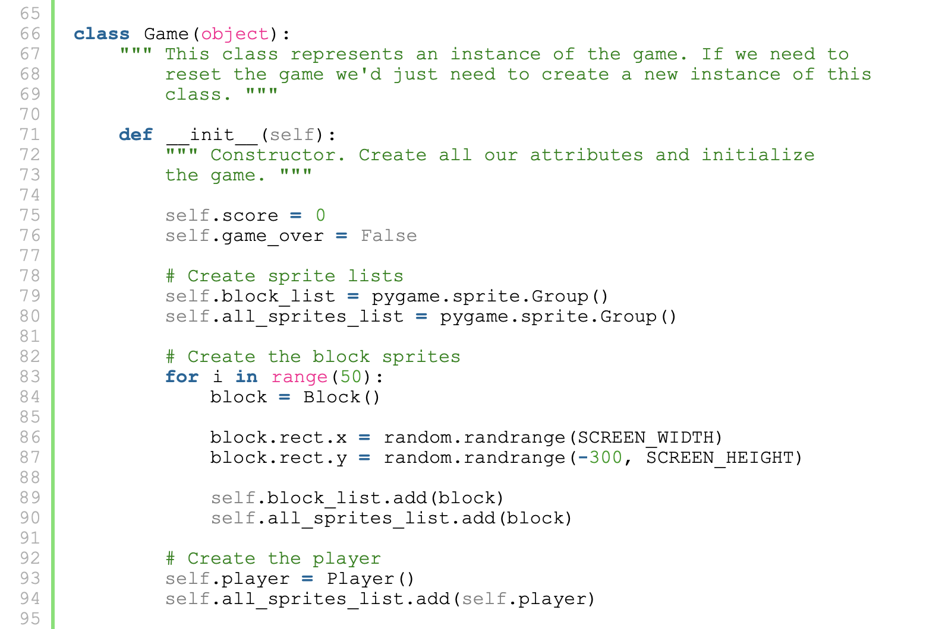
Collecting Blocks Game

Slide 21
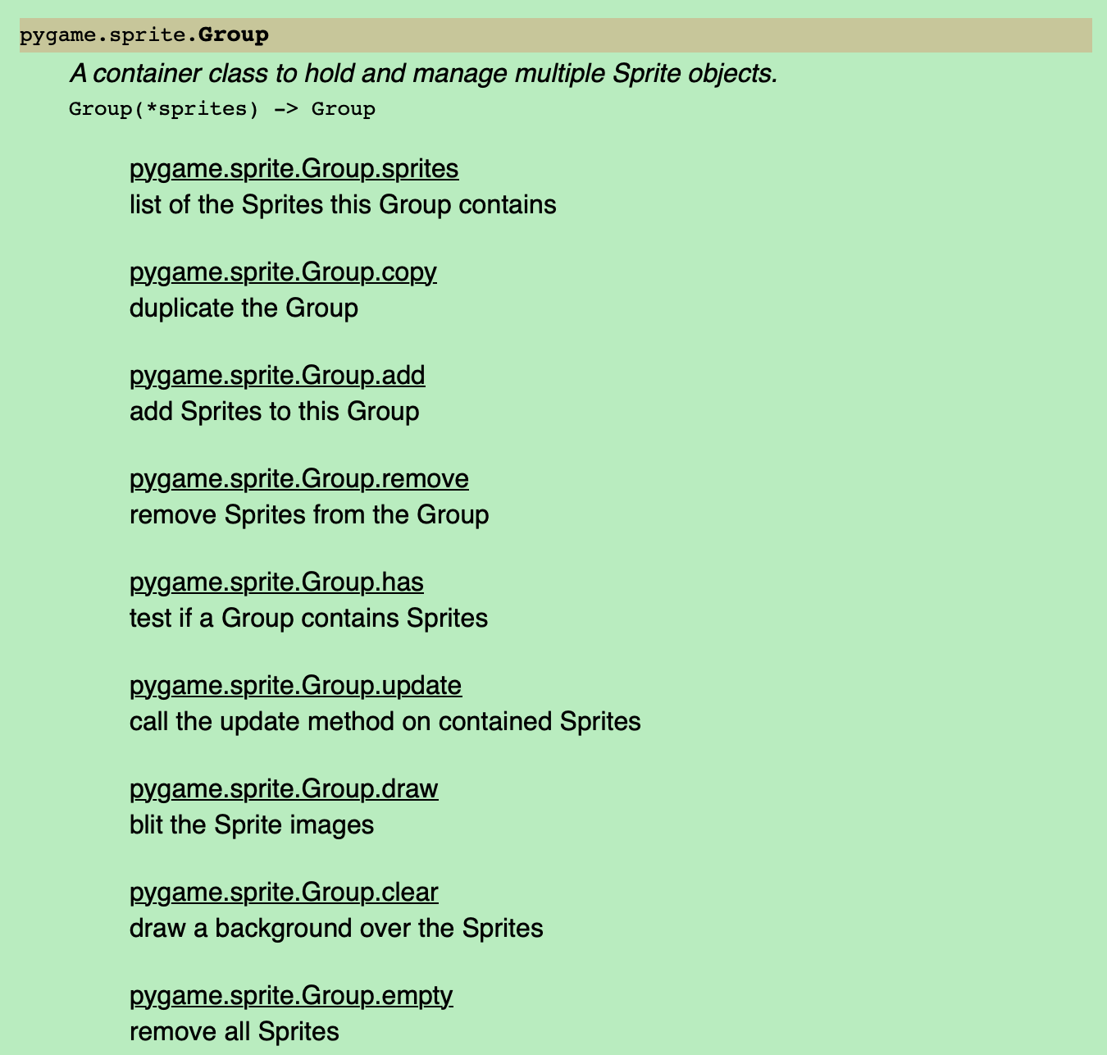
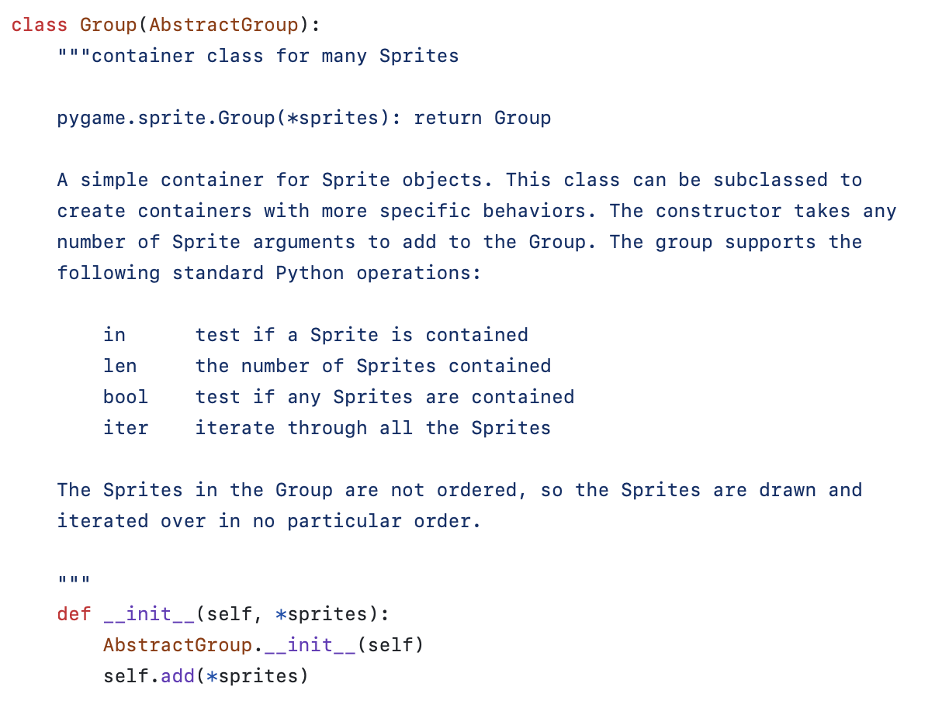
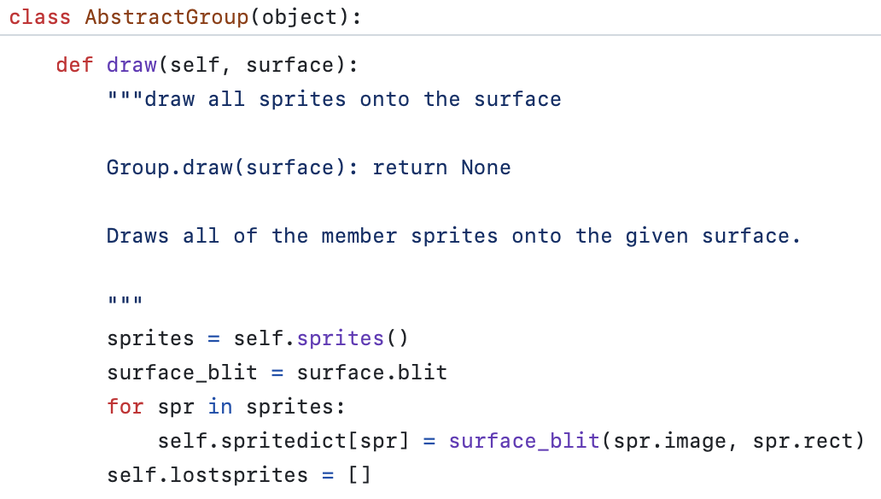
pygame.sprite.Group
Ref: https://github.com/myint/pygame/blob/master/lib/sprite.py
Ref: https://www.pygame.org/docs/ref/sprite.html#pygame.sprite.Sprite

Slide 22
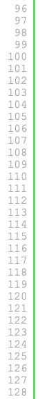
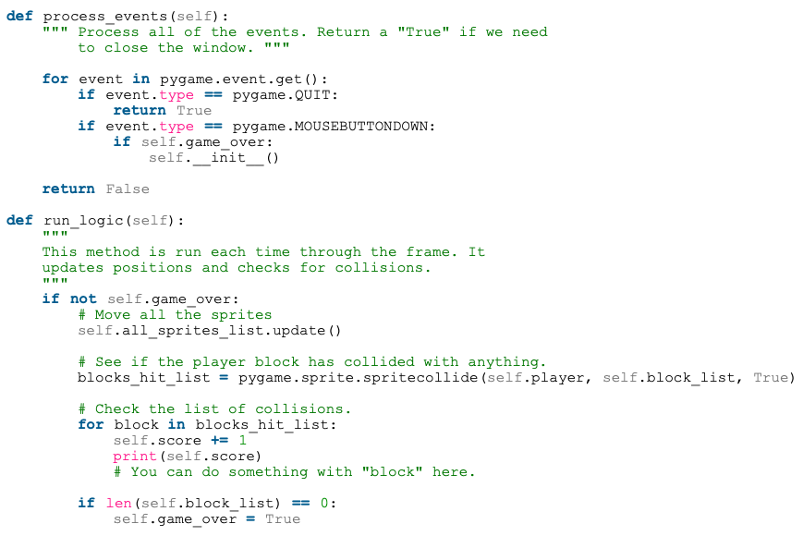
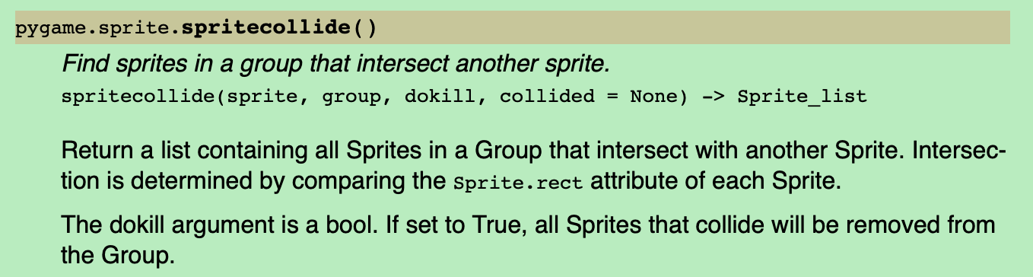
Collecting Blocks Game
UI (View) handling
This function should be moved to the Main Program?
Never happen; Try changing the condition!

Slide 23
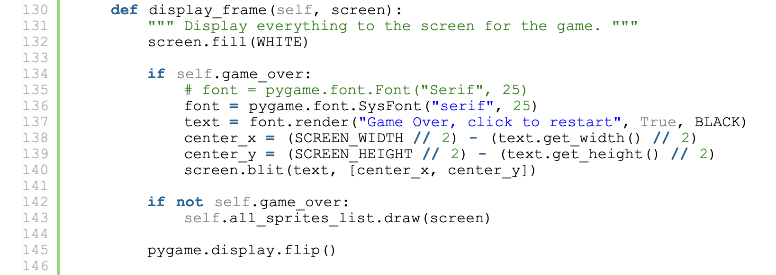
Collecting Blocks Game

Slide 24
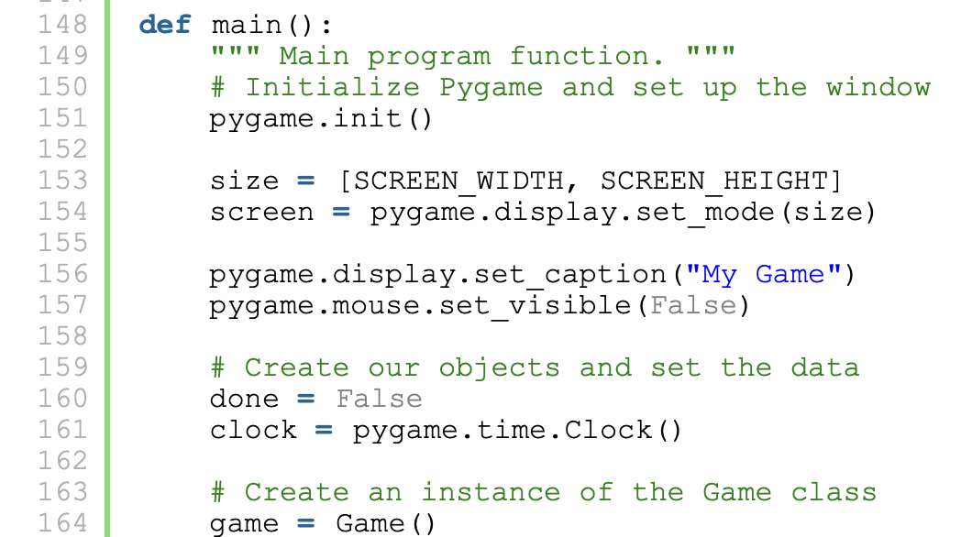
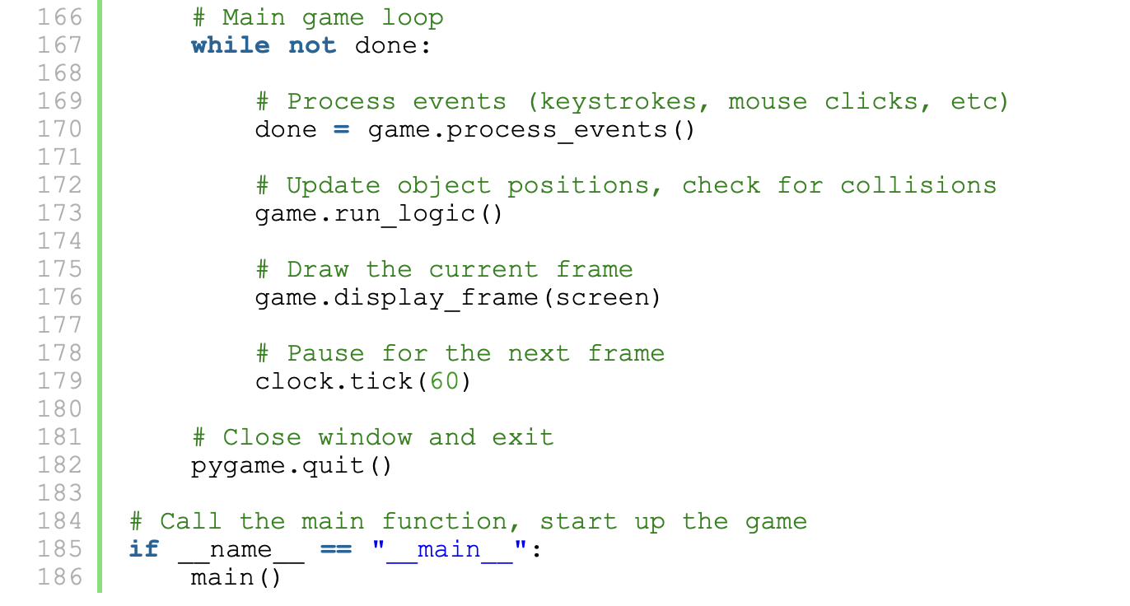
Collecting Blocks Game

Slide 25
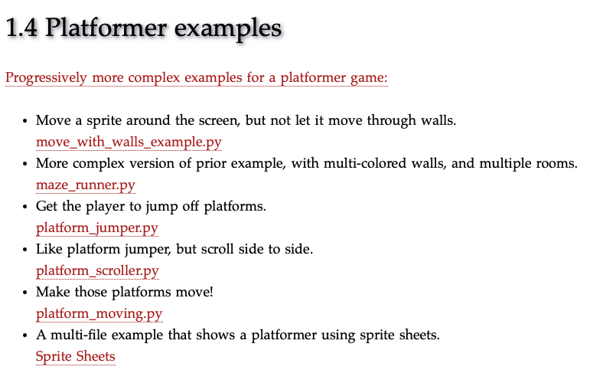

Slide 26
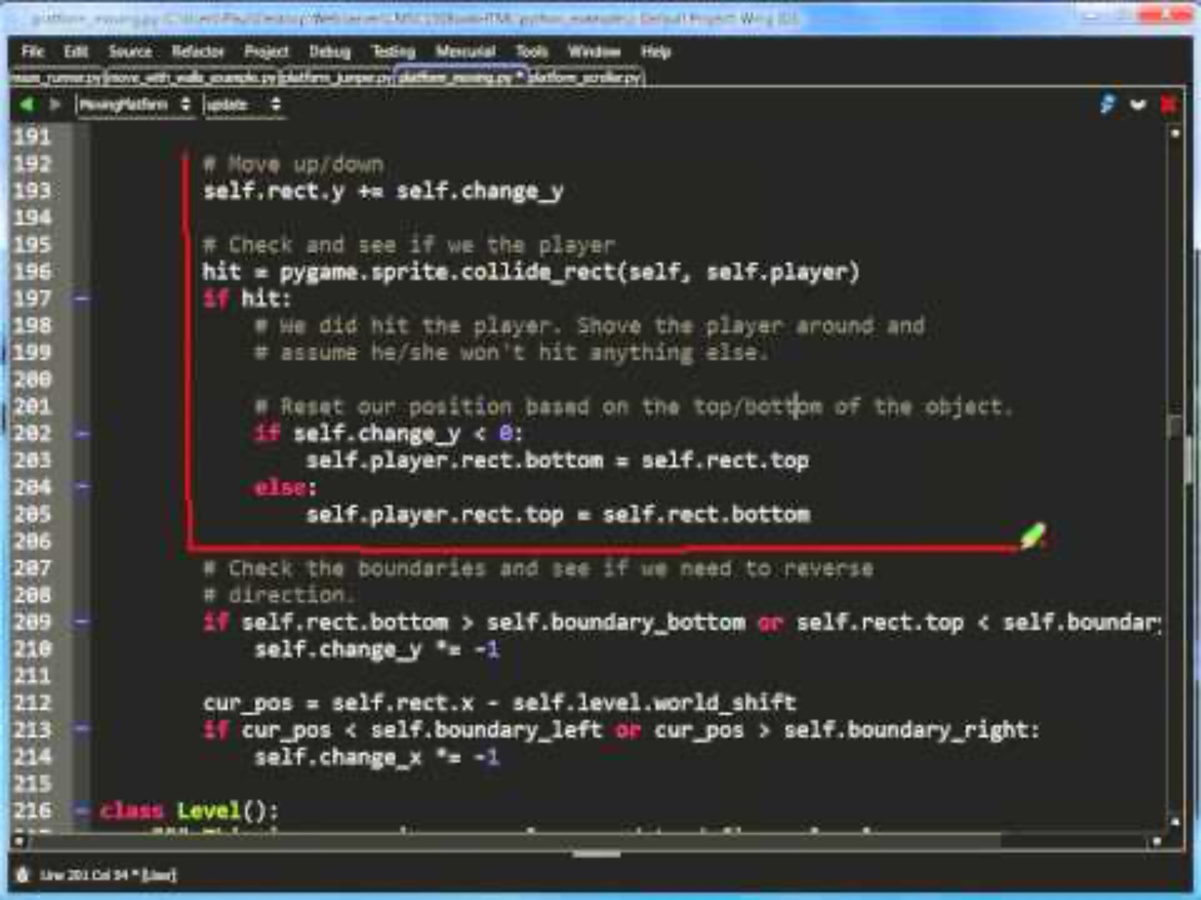
Mario-Like Game
Platform
Level
MovingPlatform
Level_01
Level_02
Main
Player
http://programarcadegames.com/python_examples/show_file.php?file=platform_moving.py (0:00)

Slide 27
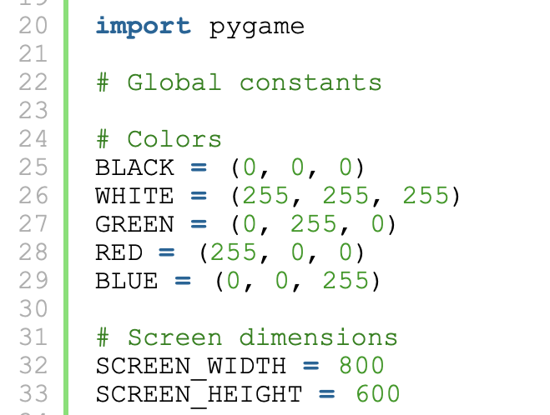
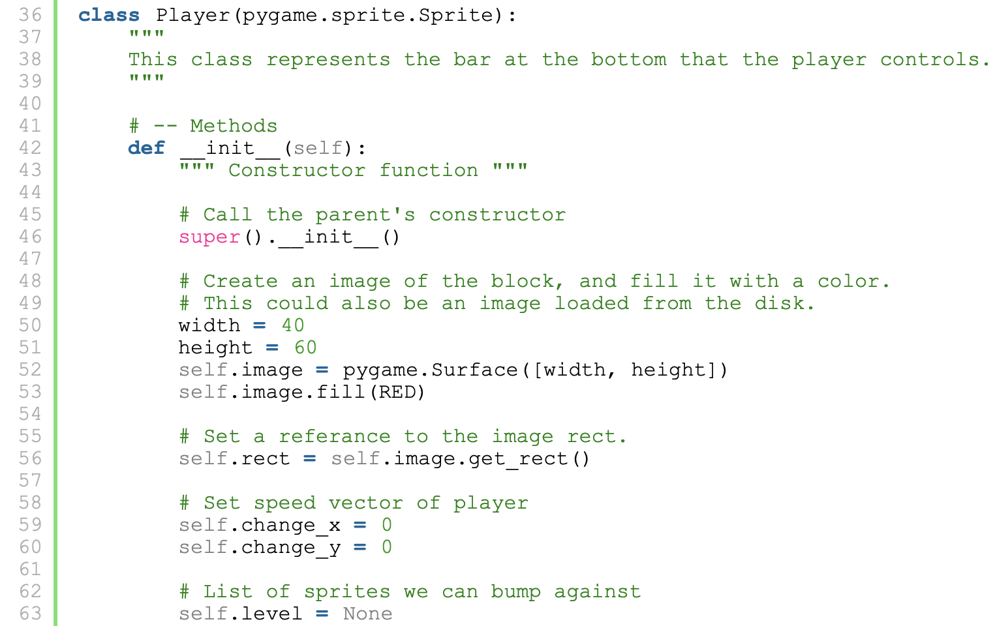
Mario-Like Game
Player
__init__
update
calc_grav
jump
go_left
go_right
stop

Slide 28
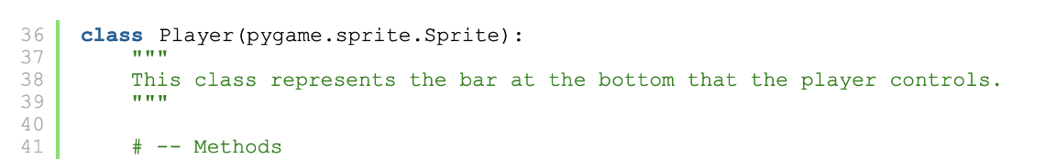
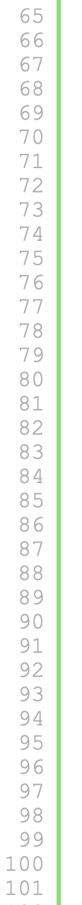
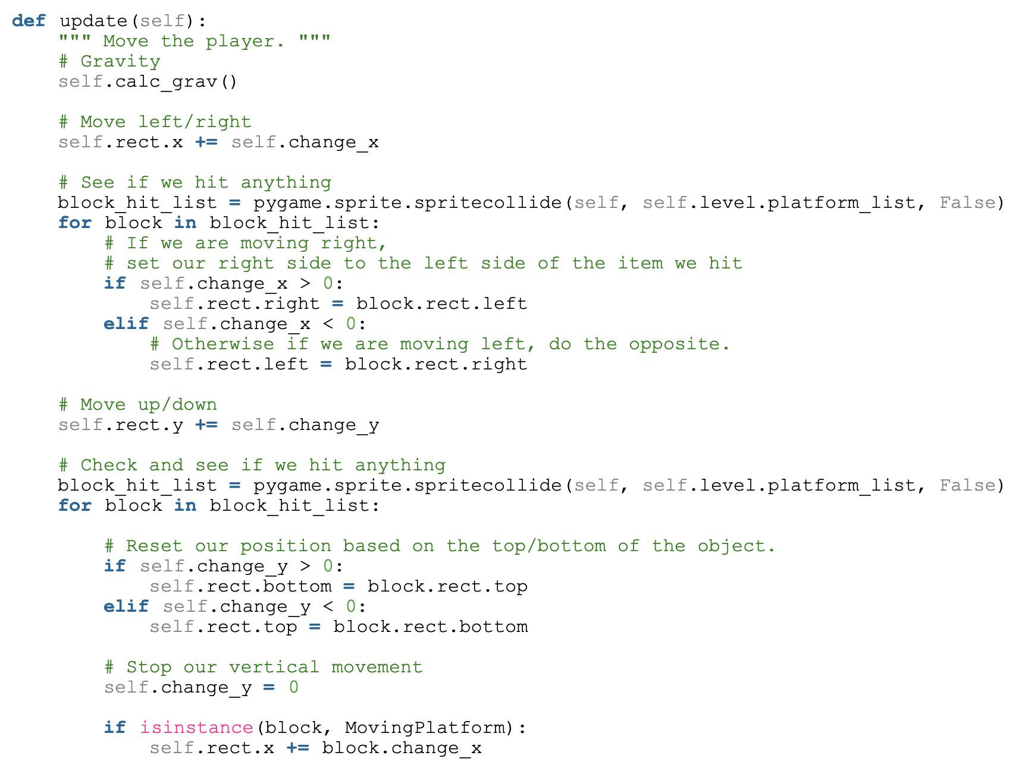
Mario-Like Game
Player
__init__
update
calc_grav
jump
go_left
go_right
stop

Slide 29
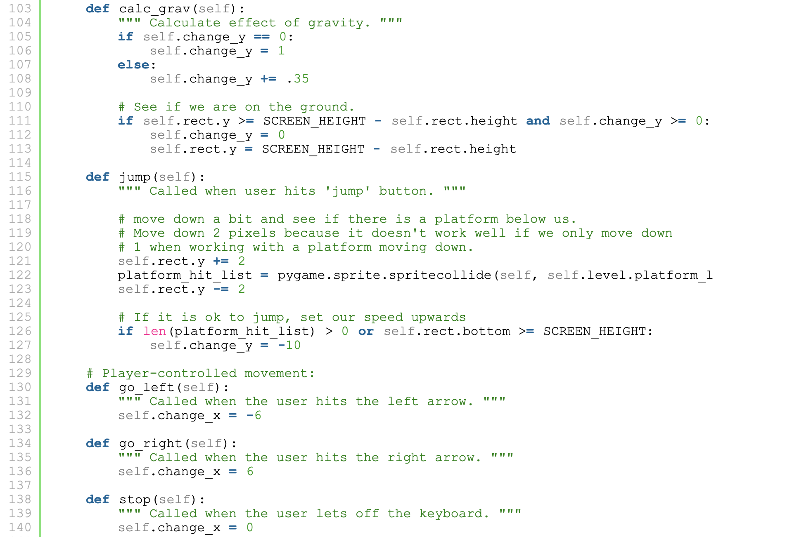
Mario-Like Game
Player
__init__
update
calc_grav
jump
go_left
go_right
stop
Notes:
calc_grav
0 => 1 why?
+=.35 # Accelerator: the velocity increases every frame

Slide 30
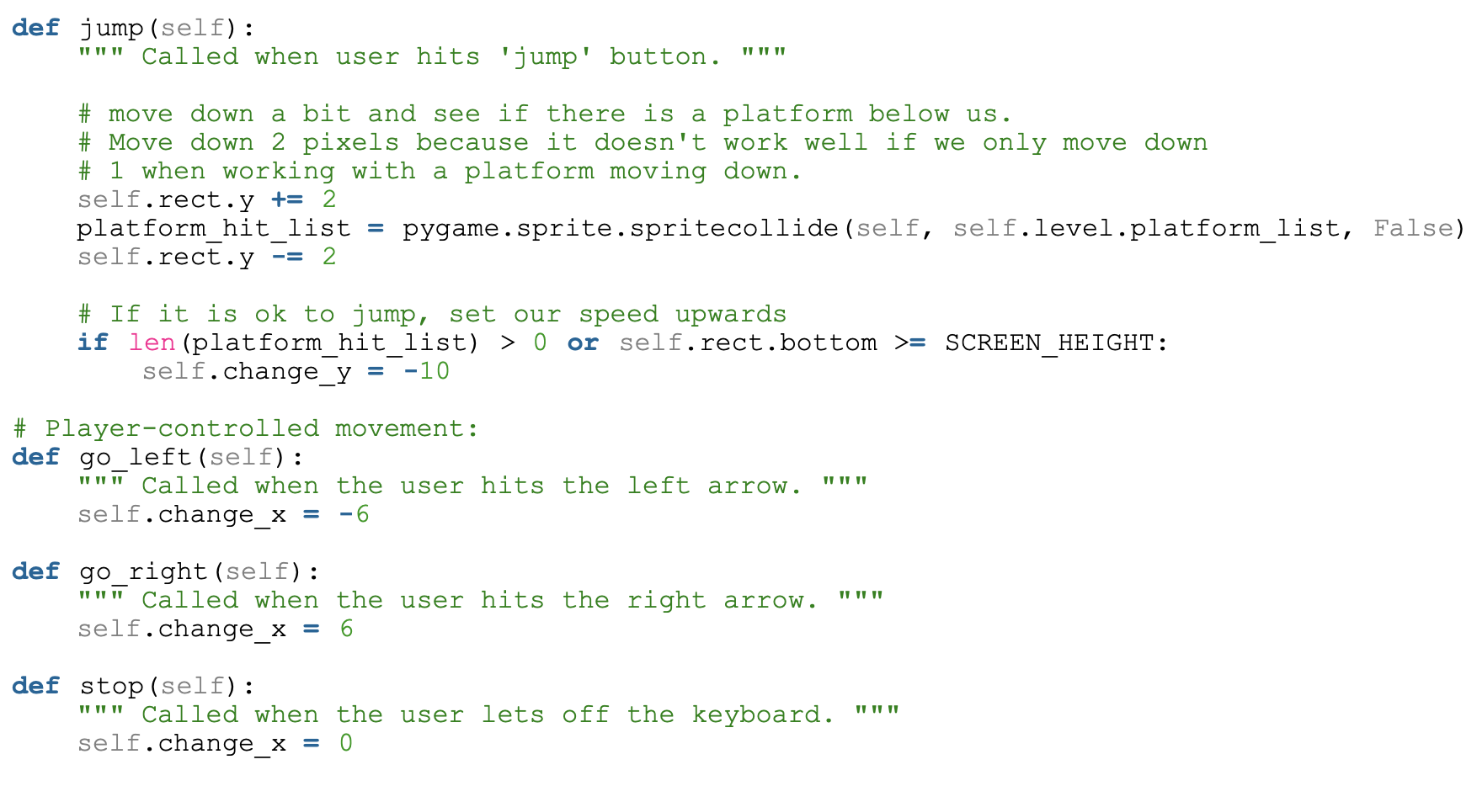
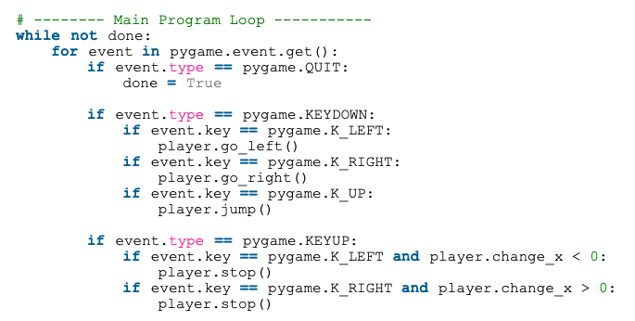
Player: stop, go_left, go_right, jump

Slide 31
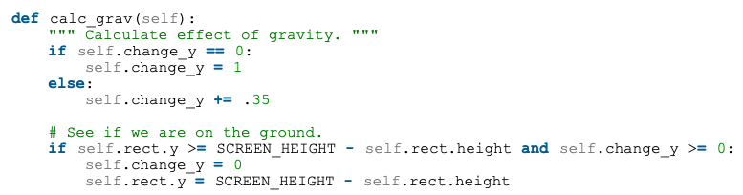
Player: calc_grav
Accelerator: The velocity (y-axis) keeps increasing every frame.

Slide 32
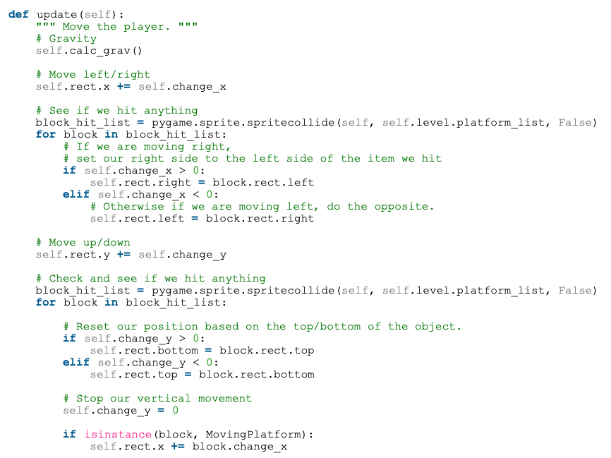
Player: update

Slide 33
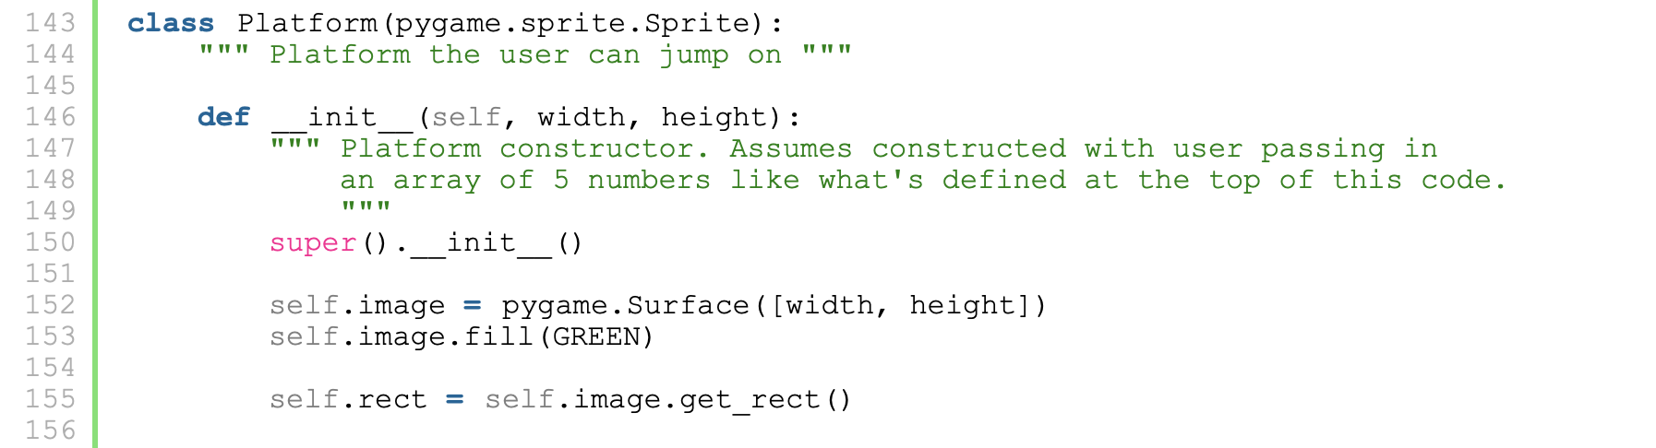
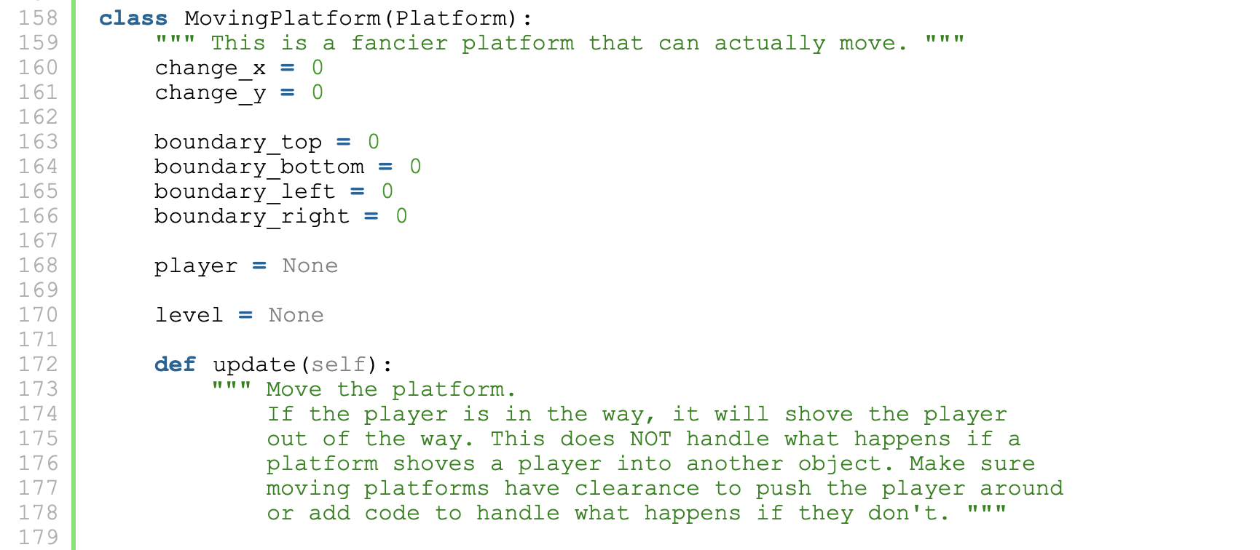
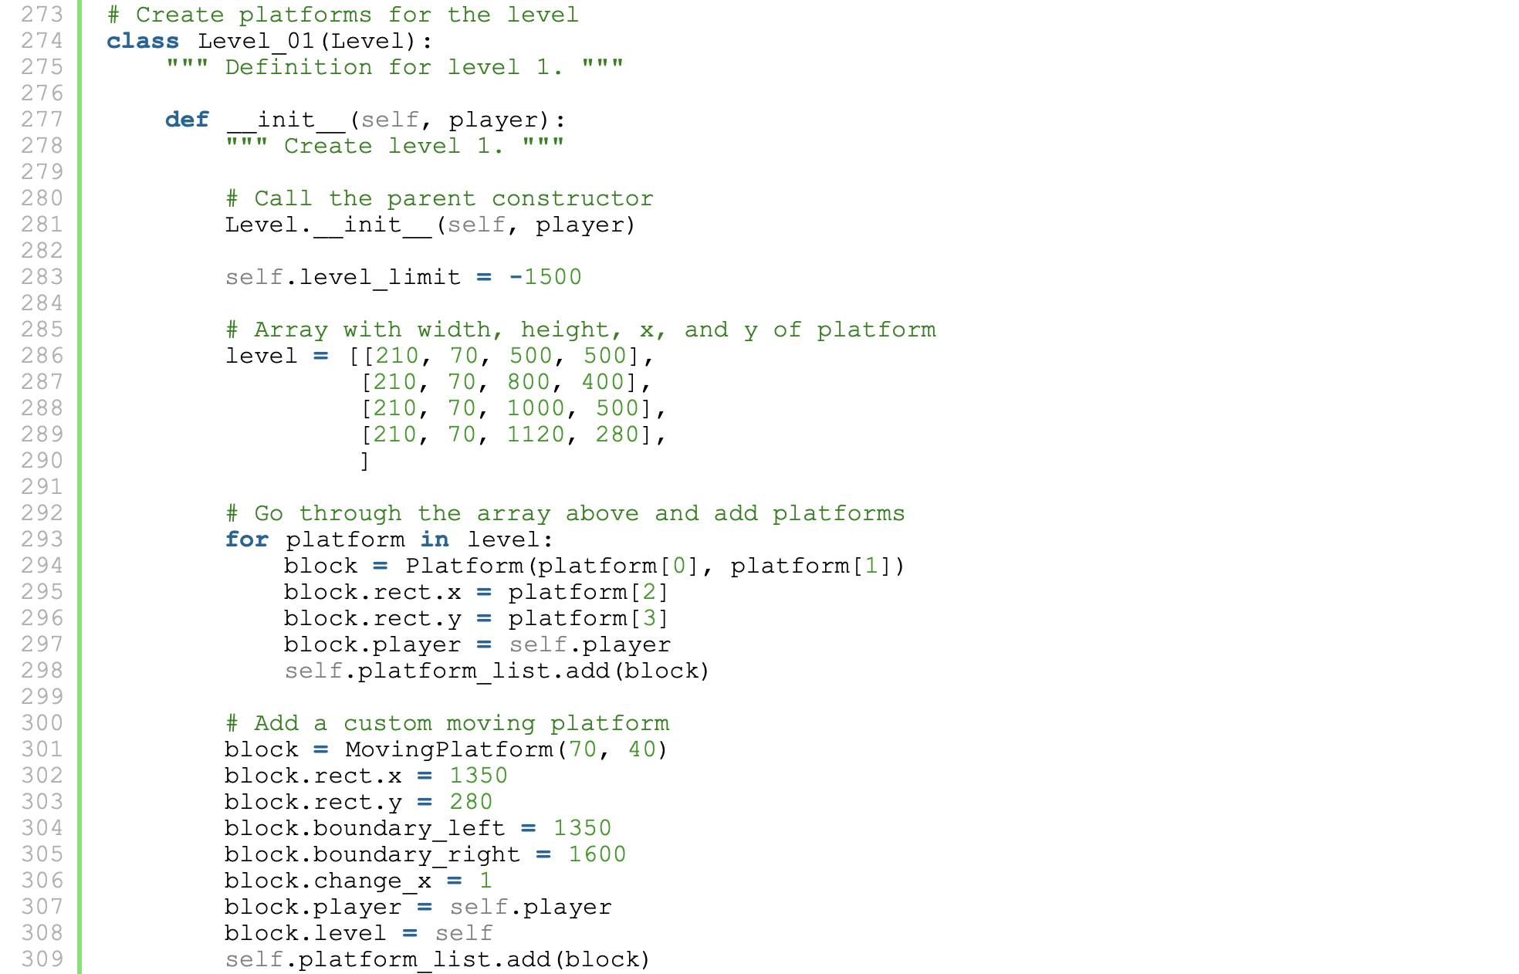
Mario-Like Game
Platform
__init__
MovingPlatform
udpate

Slide 34
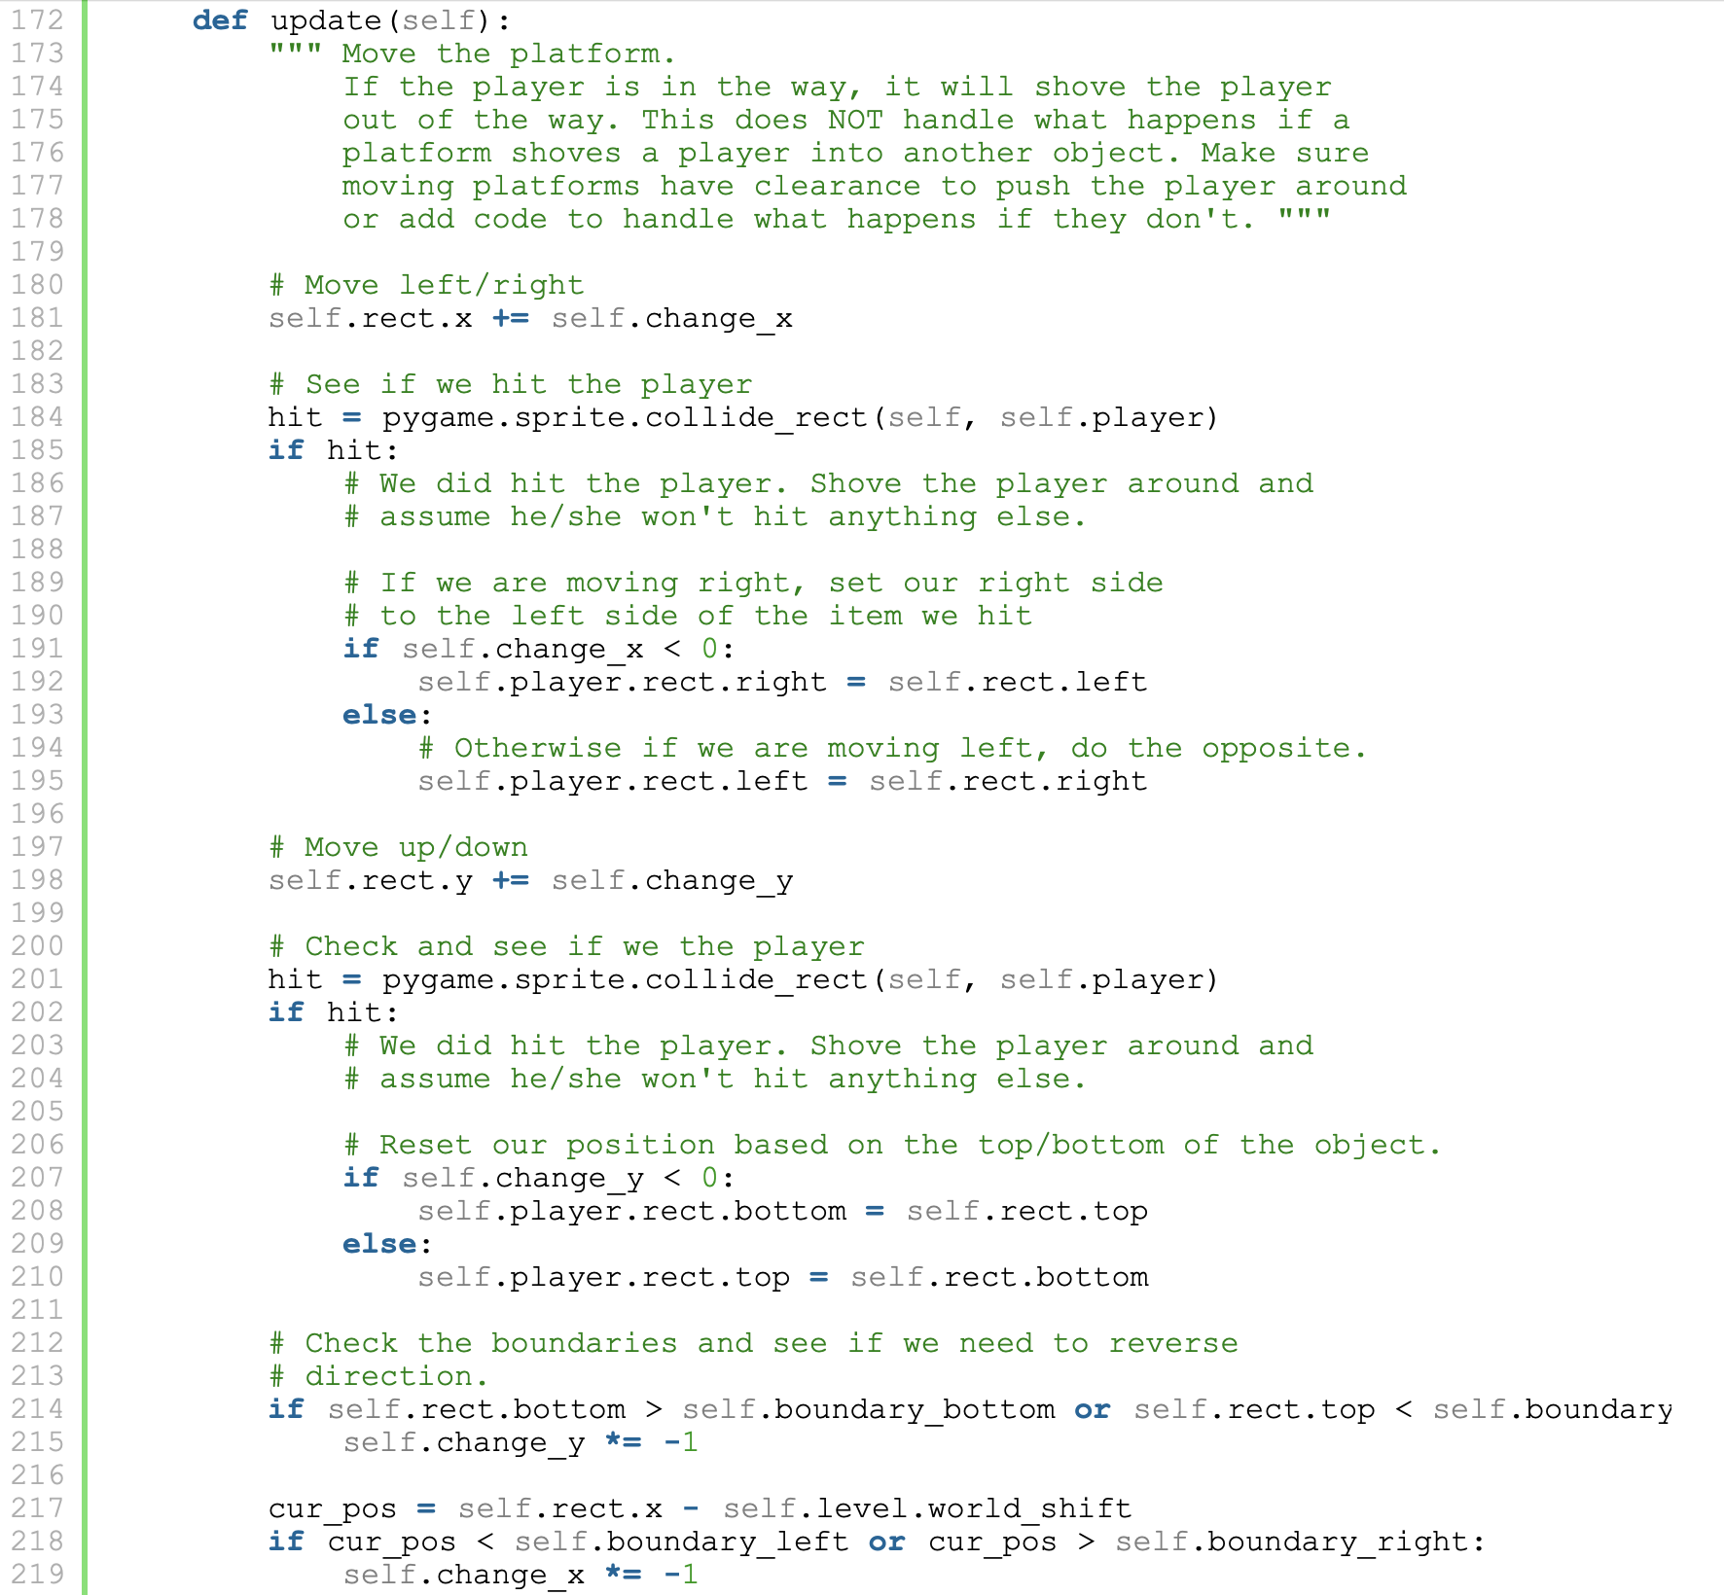
Mario-Like Game
Platform
__init__
MovingPlatform
udpate

Slide 35
MovingPlatform: update
Check collision with player only; not other platforms yet !

Slide 36
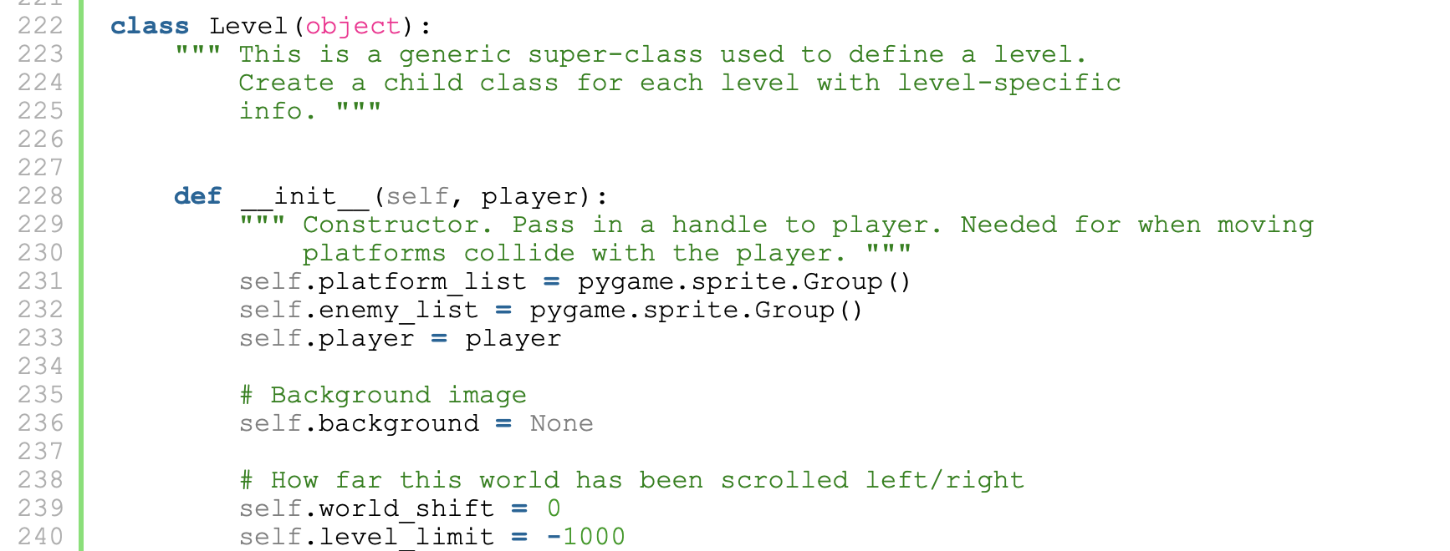
Mario-Like Game
Level
__init__
update
draw
shift_world

Slide 37
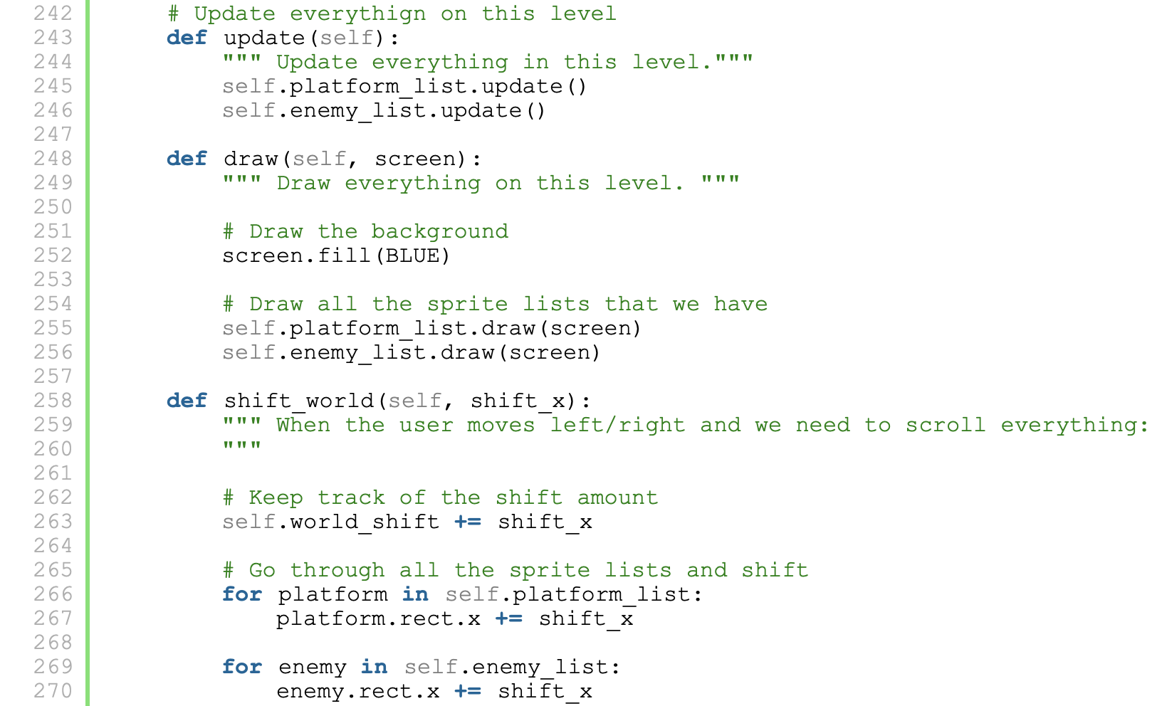
Mario-Like Game
Level
__init__
update
draw
shift_world

Slide 38
Mario-Like Game
Level
__init__
update
draw
shift_world
Level_01
__init__

Slide 39
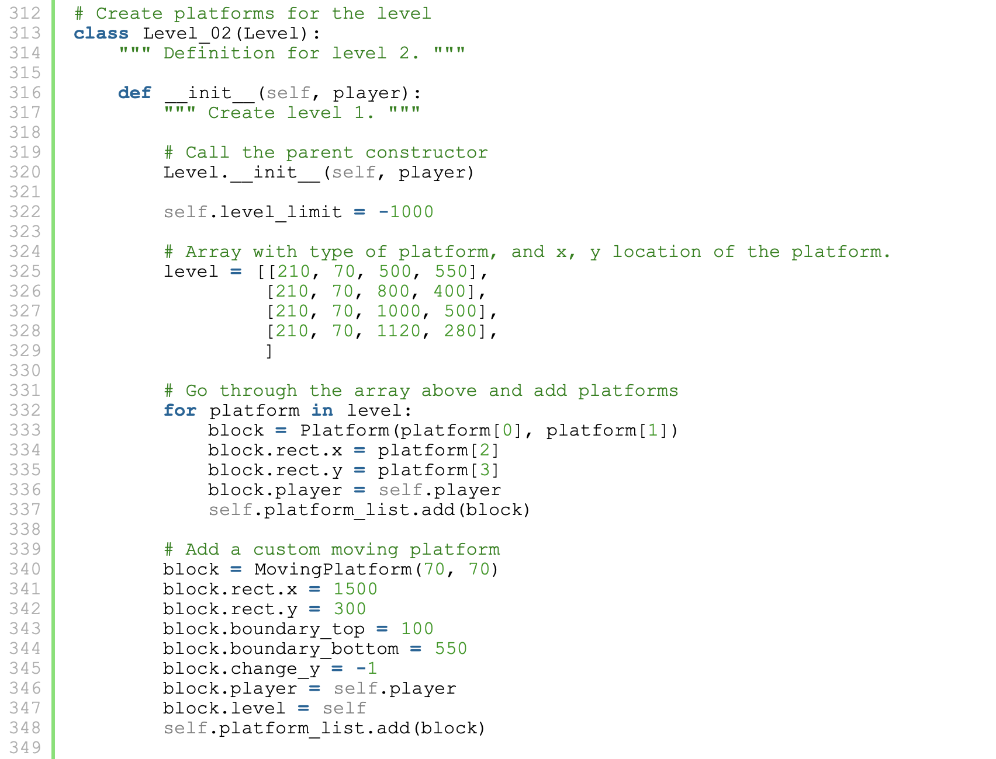
Mario-Like Game
Level
__init__
update
draw
shift_world
Level_02
__init__

Slide 40
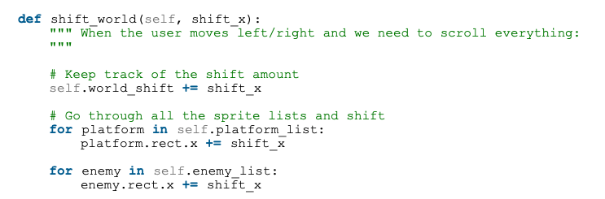
Level: shift_world

Slide 41
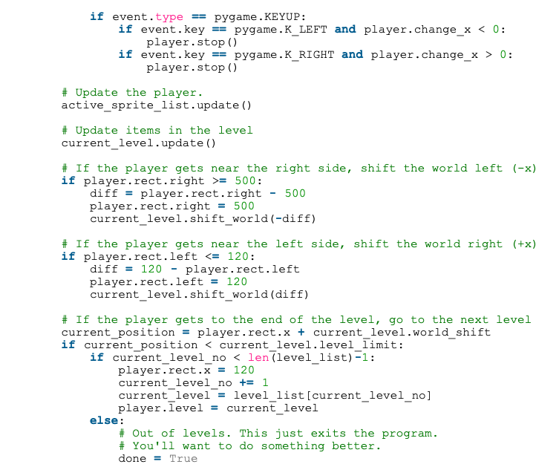

Level: shift_world
500
502
2

Slide 42
Main: Level Up
world_shift (-) < level_limit (-1000)

Slide 43

Mario-Like Game

Slide 44

Mario-Like Game

Slide 45

Mario-Like Game

Slide 46
References
http://programarcadegames.com/index.php?chapter=introduction_to_sprites&lang=en#section_13

